Slide 1
Chapter - 5 Process Synchronization
Narzu Tarannun(NAT)
Brac University
Notes:
1

Slide 2
Process Synchronization: Objectives
Concept of process synchronization.
The critical-section problem, whose solutions can be used to ensure the consistency of shared data
Software and hardware solutions of the critical-section problem
Classical process-synchronization problems
Tools that are used to solve process synchronization problems

Slide 3
What will Cover………………
Process Synchronization basic Concepts
The Critical-Section Problem
Peterson’s Solution
Synchronization Hardware
Semaphores
Classic problems of synchronization

Slide 4
Background
A cooperating process is one that can affect or be affected by other processes executing in the system.
Processes can execute concurrently or in parallel
Concurrent or parallel access to shared data may result in data inconsistency
Maintaining data consistency requires mechanisms to ensure the orderly execution of cooperating processes.
Notes:
Bounded buffer : assumes a fixed buffer size, in this case the consumer must wait if the buffer is empty and producer must wait if the buffer is full.
4

Slide 5
Process Synchronization
Process Synchronization means sharing system resources by processes in such a way that, Concurrent access to shared data is handled thereby minimizing the chance of inconsistent data. Maintaining data consistency demands mechanisms to ensure synchronized execution of cooperating processes.
Process Synchronization was introduced to handle problems that arose while multiple process executions.

Slide 6
Producer Consumer problem
A producer process produces information that is consumed by a consumer process.
Suppose that we wanted to provide a solution to the consumer-producer problem that fills all the buffers(actually support bounded buffer). This buffer will reside in a region of memory that shared by the producer and consumer processes.
We can do so by having an integer count that keeps track of the number of full buffers.
Initially, count is set to 0. It is incremented by the producer after it produces a new buffer and is decremented by the consumer after it consumes a buffer.
The producer and consumer must be synchronized.

Slide 7
Producer Consumer problem
The bounded buffer problem(Producer-Consumer Problem), is one of the classic problems of synchronization.
The producer tries to insert data into an empty slot of the buffer.
The consumer tries to remove data from a filled slot in the buffer.
The producer must not insert data when the buffer is full.
The consumer must not remove data when the buffer is empty.
The producer and consumer should not insert and remove data simultaneously.

Slide 8
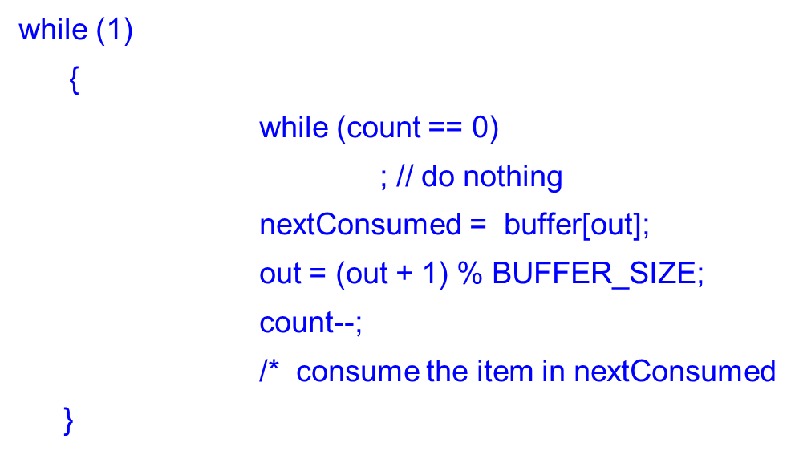
PRODUCER–CONSUMER PROBLEM
Producer
Consumer
while (true)
/* produce an item and put in nextProduced
while (count == BUFFER_SIZE)
; // do nothing
buffer [in] = nextProduced;
in = (in + 1) % BUFFER_SIZE;
count++;
}
The producer and consumer routines shown above are correct separately, they may
not function correctly when executed concurrently
Notes:
f
8

Slide 9
DATA INTEGRITY PROBLEM
Suppose the value of the variable counter is currently 5.
The produce and consumer process execute the statements “counter++” and “counter--“ concurrently.
Calling the execution of these two statements, the value of the variable counter may be 4, 5, 6!
The only correct result, though is “counter==5” which is generated correctly if the producer and consumer execute separately.

Slide 10
DATA INTEGRITY PROBLEM
count++ could be implemented as register1 = count register1 = register1 + 1 count = register1
count-- could be implemented as register2 = count register2 = register2 - 1 count = register2
register1 and register2 is local CPU registers.
Concurrent execution of “counter++” and “counter--” and allowing them to manipulate the counter variable create incorrect state.
Consider this execution interleaving with “count = 5” initially:
S0: producer execute register1 = count {register1 = 5} S1: producer execute register1 = register1 + 1 {register1 = 6} S2: consumer execute register2 = count {register2 = 5} S3: consumer execute register2 = register2 - 1 {register2 = 4} S4: producer execute count = register1 {count = 6 } S5: consumer execute count = register2 {count = 4}
We would arrive at this incorrect state because we allowed both process to manipulate the variable counter concurrently

Slide 11
Race Condition
A situation where several processes access and manipulate the same data concurrently, and the outcome of the execution depends on the particular order in which the access takes place, is called race condition.
To guard against the race condition above, we need to ensure that only one process at a time can be manipulating the variable counter. To make such a guarantee , we require that the processes be synchronized in some way.

Slide 12
Critical Section Problem
Consider system of n processes {p₀, p₁, … p_{n-1}}
Each process has critical section segment of code
In which the process may be changing common variables, updating table, writing file, etc
When one process is executing in its critical section, no other process is to be allowed to execute in its critical section
That is no two processes are executing in their critical sections at the same time.
Critical section problem is to design a protocol that the processes can use to cooperate
Each process must ask permission to enter its critical section in entry section, may follow critical section with exit section, then remainder section

Slide 13
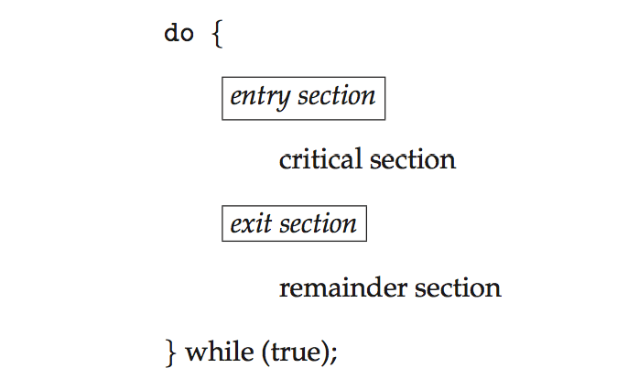
Critical Section
General structure of process P_{i}
Notes:
13

Slide 14
Requirements of solution to the Critical-Section Problem
A solution to the critical-section problem must satisfy the following three requirements:
1. Mutual Exclusion - If process P_{i} is executing in its critical section, then no other processes can be executing in their critical sections
2. Progress - If no process is executing in its critical section and there exist some processes that wish to enter their critical section, then only those processes that are not executing in their remainder sections can participate in the decision on which will enter its critical section next, and this selection cannot be postponed indefinitely
3. Bounded Waiting - A bound must exist on the number of times that other processes are allowed to enter their critical sections after a process has made a request to enter its critical section and before that request is granted
Assume that each process executes at a nonzero speed

Slide 15
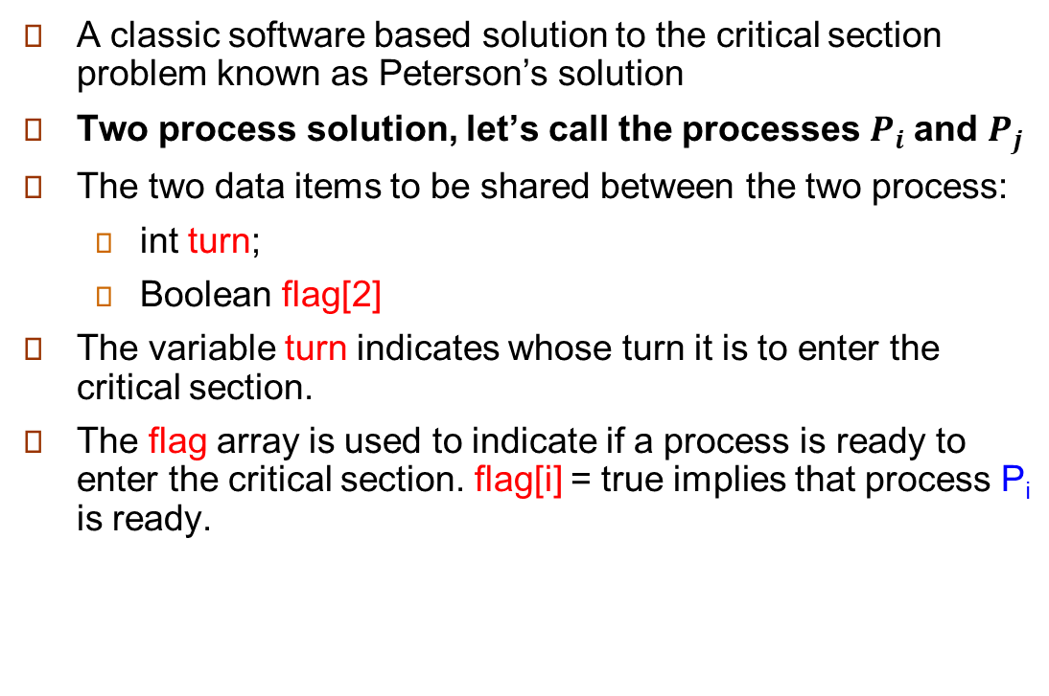
Peterson’s Solution

Slide 16
Peterson’s Solution for process P_{i}
Structure of process P_{i} in Peterson’s Solution
Structure of process P_{j} in Peterson’s Solution
do {
flag[i] = TRUE ;
turn = j ;
while ( flag[j] && turn == j) ;
Do no-op
CRITICAL SECTION
flag [ i ] = FALSE ;
REMAINDER SECTION
} while (TRUE) ;
do {
flag[j] = TRUE ;
turn = i ;
while ( flag[i] && turn == i) ;
Do no-op
CRITICAL SECTION
flag [ j ] = FALSE ;
REMAINDER SECTION
} while (TRUE) ;

Slide 17
Example of Peterson Problem
For Peterson’s problem below conditions will applied.
Each statement will take 2ms to complete.
For process 0: i=0,j=1; and for process 1: i=1,j=0.
Context switching will occur after 4ms.
In critical section area carried only 3 statements.
In remainder section area carried only 2 statements.
Initial information common to both processes:
turn=0;
flag[0]=FALSE;
flag[1]=FALSE;

Slide 19
Synchronization Hardware
Many systems provide hardware support for critical section code
Uniprocessors or single processor– could disable interrupts while modified a shared variable.
Currently running code would execute without preemption. So no unexpected modifications could be made to the shared variable.
This is the approach taken by non-preemptive kernels.
Generally too inefficient on multiprocessor systems
Because, disabling interrupts on a multiprocessor can be time consuming.
Modern machines provide special atomic hardware instructions: TestAndSet ; Compare and Swap ;
Atomic = non-interruptable
Either test memory word and set or modify the content of a word
Or swap contents of two memory words

Slide 20
test_and_set Instruction
There is a shared lock variable which can take either of the two values, 0 or 1.
Before entering into the critical section, a process inquires about the lock.
If it is locked, it keeps on waiting till it becomes free.
If it is not locked, it takes the lock and execute the critical section.
Definition:
boolean test_and_set (boolean *target)
{
boolean rv = *target;
*target = TRUE;
return rv:
}
Executed atomically
Returns the original value of passed parameter
Set the new value of passed parameter to “TRUE”.
Notes:
20

Slide 21
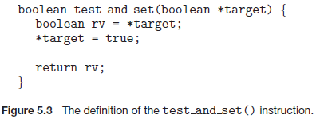
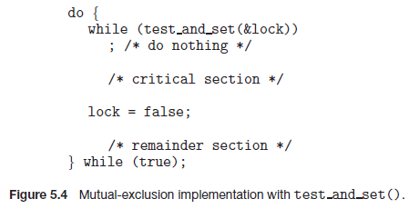
test_and_set Instruction and its implementation
Mutual exclusion can be implemented by initializing a Boolean variable lock to false
Notes:
It ensures mutual exclusion.
It ensures freedom from deadlock.
It may cause the process to starve for the CPU.
It does not guarantee that processes will always execute in a FIFO order otherwise there would be no starvation.
21

Slide 22
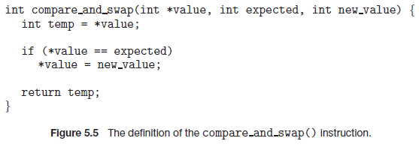
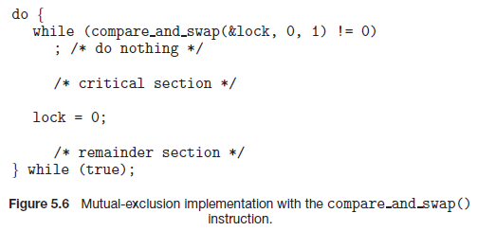
COMPARE_AND_SWAP() INSTRUCTION
Mutual exclusion can be achieved by declaring a global variable lock and initializing it to 0
First process that invokes this instruction will set lock to 1 and no other process can execute CS until this process updates it to 0 after CS execution.

Slide 23
Mutex Locks
Previous solutions are complicated and generally inaccessible to application programmers
OS designers build software tools to solve critical section problem
Simplest is” mutex lock” ( Mutex = Mutual Exclusion)
Protect a critical section by first acquire() a lock then release() the lock
Boolean variable indicating if lock is available or not
Calls to acquire() and release() must be atomic
Usually implemented via hardware atomic instructions
But this solution requires busy waiting
This lock therefore called a spinlock
Notes:
23

Slide 24
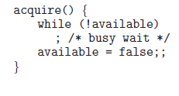

Solution to Critical-section Problem Using mutex Locks
do {
acquire lock
critical section
release lock
remainder section
} while (TRUE);
A simple tool requires-lock
Race conditions are prevented by requiring that critical section be protected by locks.

Slide 25
Semaphore Variables
Hardware based solution to the Critical Section (CS) problem are complicated for application programmer to use. To overcome this difficulty a synchronization tool called semaphore can be used.
A semaphore is a protected integer variable that can facilitate and restrict access to shared resources in a multi-processing environment.
This variable is used to solve critical section problem and to achieve process synchronization in multi-processing environment.

Slide 26
Semaphore Variables
Semaphore S is an integer variable ; can not modify directly. Using two standard atomic operations we can modify wait() and signal()
Originally called P( ) and V( ) (Less complicated)
Wait( ) or P( ) means to “test”
Signal( ) or V( ) means to “increment”

Slide 27
Semaphore Variable Definition
P(Semaphore S) { V(Semaphore S) {
while (S ≤ 0) S = S+1;
; // No operation }
S = S-1;
}
P(S) and V(S) operations are atomic in nature that means when a process executing the process P(S) or V(S) that can not be Interrupted.
All the modifications to the integer value of the semaphore in the wait() and signal() operations must be executed individually. That is, when one process modifies the semaphore value, no other process can simultaneously modify that same semaphore value.
Using semaphore we can implement mutual exclusion very easily.

Slide 28
implement mutual exclusion using Semaphore Variable
P(Semaphore S) { V(Semaphore S) {
while (S ≤ 0) S = S+1;
; // No operation }
S = S-1;
}
Implementation with mutex lock:
mutex: Semaphore; mutex = 1;
P_{i}: P(mutex)
CS //Critical Section
V(mutex)
RS //Remainder Section

Slide 29
Two types of semaphore
Binary semaphore – If there is a single resource(CS) only , integer value can range only between 0 and 1; can be simpler to implement
Also known as mutex lock.
Binary semaphore (mutex) initialized to 1which provides mutual exclusion, used to solve CS problem.[example shown in previous slide]
Can solve various synchronization problems:
Here is an example of deciding the order of execution of process.
Consider P₁ and P₂ are two processes that require S₁ to happen before S₂
P₁ has statement S₁
P₂ has statement S₂
Create a semaphore variable “sync” initialized to 0
P1:
S1;
signal(sync);
P2:
wait(sync);
S2;

Slide 30
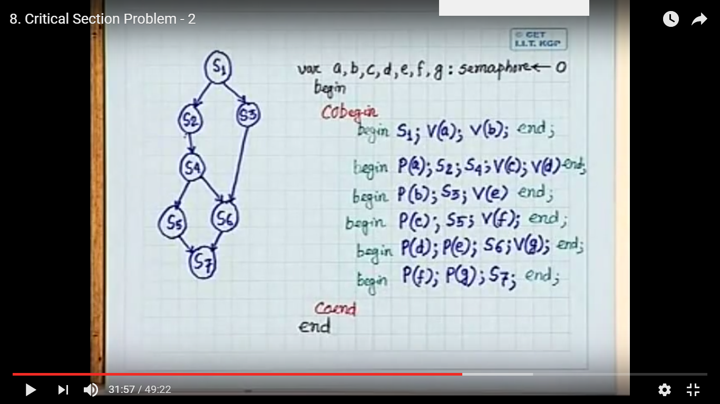
Process Synchronization using semaphore variable
Notes:
30

Slide 31
Two types of semaphore
Counting semaphore –The value can range over an unrestricted domain.
Used to control access to a given resource consisting of finite number of instances. If there are more than one but limited resources.
Initialized to the number of resources available, S = n
Each process that wishes to use a resource performs a wait() operation
S = S -1
When a process releases a resource, it performs a signal() operation
S = S +1
When S becomes 0, all resources are being used
processes that wish to use a resource will block until S>0

Slide 32
Problem with Semaphore Implementation
The main disadvantages of semaphore is it requires busy waiting.
While a process is in it’s critical section, any other process that tries to enter it’s critical sections must loop continuously in the entry code. This is called busy waiting and it wastes CPU cycles. When a semaphore does this, it is called a spinlock.
Busy waiting wastes CPU cycles that some other processes might be able to use productively.
Notes:
32

Slide 33
Semaphore Implementation with no Busy waiting
To avoid busy waiting each semaphore there is an associated waiting queue of process that are waiting to access the critical section.
Rather than using a semaphore as a variable we can use it as a structure or record which have two fields:
value (of type integer)
list of the processes/ pointer to next record in the list
Declaration of semaphore as a structure
typedef struct{
int value;
struct process *list;
} semaphore;
Declaration of semaphore as a record
semaphore = record
value : integer;
L : list of processor;
end;

Slide 34
Semaphore Implementation with no Busy waiting
Two operations provide: block() & wakeup()
When a process executes the wait() operation and finds that the semaphore value is not positive, it must wait
Rather than this busy waiting, the process can block itself which places it into a waiting queue associated with the semaphore
State of the process is switched to the waiting state and control is transferred to CPU scheduler which selects another process to execute.
It will be restarted when some other process executes a signal() operation
Restarted by a wakeup() operation that changes it from waiting state to ready state.
"No busy waiting" means that whenever the process wakes up from waiting, the condition it was waiting for should hold. That is, it must not wake up, find the condition false, and again wait on the same semaphore.

Slide 35
Semaphore Implementation with no Busy waiting
Structure semaphore{
int value;
queue L;
}
wait (S){
s.value=s.value-1;
if (s.value <0)
{add this process S.L to waiting queue
block( );
}
}
Signal (S)
{
S.value=S.value+1;
if (S.value<=0)
{ remove a process S.L from the waiting queue;
wakeup( ); }
}

Slide 36
Deadlock and Starvation
Deadlock – The implementation of a semaphore with a waiting queue may result in a situation where two or more processes are waiting indefinitely for an event that can be caused only by one of the waiting processes.
Let S and Q be two semaphores initialized to 1
P₀ P₁
wait (S); wait (Q);
wait (Q); wait (S);
. .
. .
. .
signal (S); signal (Q);
signal (Q); signal (S);
Starvation – indefinite blocking. A process may never be removed from the semaphore queue in which it is suspended.

Slide 37
Classical Problems of Synchronization
Bounded-Buffer Problem
Readers and Writers Problem
Dining-Philosophers Problem

Slide 38
Bounded-Buffer Problem
The problem describes two processes, the producer and the consumer, who share a common, fixed-size buffer used as a queue. The producer's job is to generate a piece of data, put it into the buffer and start again. At the same time, the consumer is consuming the data (i.e., removing it from the buffer) one piece at a time.
The problem is to make sure that the producer won't try to add data into the buffer if it's full
and that the consumer won't try to remove data from an empty buffer.
The producer and consumer should not insert and remove data simultaneously.

Slide 39
Solution for Bounded-Buffer Problem
The solution for the producer is to either go to sleep or discard data if the buffer is full. The next time the consumer removes an item from the buffer, it notifies the producer, who starts to fill the buffer again.
In the same way, the consumer can go to sleep if it finds the buffer to be empty. The next time the producer puts data into the buffer, it wakes up the sleeping consumer.

Slide 40
Inadequate implementation
In the solution two library routines are used, sleep and wakeup. When sleep is called, the caller is blocked until another process wakes it up by using the wakeup routine. The global variable itemCount holds the number of items in the buffer.

Slide 41
Inadequate Solution/ Implementation
procedure producer(){
while(true){
item = produceItem();
if(itemCount == BufferSize)
Sleep();
putIntoBuffer(item);
itemCount ++;
if(itemCount == 1)
wakeup(consumer);
}
}
procedure consumer(){
while(true){
if(itemCount == 0)
Sleep();
item = removeFromBuffer();
itemCount --;
if(itemCount == BufferSize - 1)
wakeup(producer);
}
}
DEADLOCK !!!
If, consumer is interrupted just after checking the itemCount value and before sleep() call, and producer produces an item it will call wakeup(). But, this call will be lost as no consumer in sleeping yet. And it will continue to produce items. Eventually, producer will sleep when the buffer is full. On the other hand, consumer will also stay in sleep as producer won’t call wakeup().

Slide 42
it contains a race condition
Since both processes will sleep forever, we have run into a deadlock. This solution therefore is unsatisfactory

Slide 43
Use of Semaphore Solution for multiple producer and consumer
Solves the lost wakeup call by using two semaphore - countFill, countEmpty,
countFill: number of available item in the buffer to be read/ consume
countEmpty: number of available space in the buffer to write/ produce
Problem & solution
this solution still contains a serious race condition that could result in two or more processes produce or consume into the same slot at the same time.
So for that we can use mutex semaphore which provides mutual exclusion for accesses to the buffer pull and is initialized to the value 1.
Notes:
this solution contains a serious race condition that could result in two or more processes produce or consume into the same slot at the same time.
43

Slide 44
Semaphore for multiple producer consumer
semaphore mutex = 1;
semaphore countFull = 0;
semaphore countEmpty = BUFFER_SIZE;
procedure producer(){
do{
wait(countEmpty); //wait until empty>0 and then decrement ‘empty’
wait(mutex); //acquire lock
/* add data to buffer*/
signal(mutex); // release lock
signal(countFull); // increment ‘full’
}
} while(true)
procedure consumer(){
do{
wait(countFull);//wait until full>0 then decrement ‘full’
wait(mutex); //acquire lock
/* remove data from buffer*/
signal(mutex); // release lock
signal(countEmpty);// increment ‘empty’
}
} while(true)
The order in which different semaphores are incremented or decremented is essential: changing the order might result in a deadlock.

Slide 45
The Readers-Writers Problem
There is a data area or Database that is shared among a number of concurrent processes.
Some of these processes may want only to read the database, whereas others may want to update (write) the database.
We distinguish between these two types of processes by referring to the former as readers and to the later as writers.
Obviously if two readers access the data simultaneously, no adverse effects will result.
If a writer and some other thread (either a reader or writer) access database the simultaneously, chaos may ensure.
To ensure that these difficulties do not arrives, we require that the writers have exclusive access to the shared database.
These synchronization problem is referred to as Readers-Writers Problems.

Slide 46
Readers-Writers Problem
Data/ database is shared among number of processes
Any number of readers may simultaneously read the data
Only one writer can write to the data at a certain time
If a writer is writing, no reader can read
If at least one reader is reading, no writer can start writing
Readers only read, Writers only write

Slide 47
Readers-Writers Problem
The reader-writers has several variations, all involving priorities.
first reader-writers problem, requires that no reader will be kept waiting unless a writer has already obtained permission to use the shared object. In other words no reader should wait for other reader to finish simply because a writer is waiting.
second reader-writers problem- requires that, once a writer is ready, that writer performs it write as soon as possible. In other words if a writer is waiting to access the object, no new readers may start reading.
Solution to either problem may create starvation.
First case: writer may starve
Second case: reader may starve

Slide 48
Readers-Writers Problem
Solution to First Variation / case
We will make use of two semaphores and integer variable
semaphore rw_mutex = 1;
semaphore mutex = 1;
int read_count = 0;
The semaphore rw_mutex is common to both reader and writer processes.
The mutex semaphore is used to ensure mutual exclusion when the variable read_count is updated. i.e. whenany reader enters or exit from the critical section.
The read_count variable keeps track of how many processes are currently reading the object.

Slide 49
Readers-Writers Problem
writer process has the following code skeleton -
do{
/* write request for critical section*/
wait(rw_mutex);
/* writing is performed */
// Leaves the critical section //
signal(rw_mutex);
} while(true);
If a writer is in the critical section and n readers are waiting
One reader is queued on rw_mutex
Other n-1 readers are queued on mutex
When a writer executes signal(rw_mutex)
Resume the execution of either waiting readers or single waiting writer

Slide 50
Readers-Writers Problem
reader process has the following code skeleton -
do{
wait(mutex);
read_count++; // the number of readers has now increased by 1
if(read_count == 1)
wait(rw_mutex); //this ensure no writer can enter if there is even one reader
signal(mutex); //Other readers can enter while this current reader is inside the critical section
/* reading is performed */
wait(mutex);
read_count--; //reader wants to leave
if(read_count == 0) //no reader is left in the critical section.
signal(rw_mutex); //writers can enter
signal(mutex) //reader leaves
} while(true);

Slide 51
Dining-Philosophers Problem
Problem statement
Five silent philosophers sit at a round table with bowls of spaghetti. Forks are placed between each pair of adjacent philosophers.
Each philosopher must alternately think and eat. However, a philosopher can only eat spaghetti when he has both left and right forks. Each fork can be held by only one philosopher and so a philosopher can use the fork only if it is not being used by another philosopher. After he finishes eating, he needs to put down both forks so they become available to others. A philosopher can take the fork on his right or the one on his left as they become available, but cannot start eating before getting both of them.
Eating is not limited by the remaining amounts of spaghetti or stomach space; an infinite supply is assumed. assuming that no philosopher can know when others may want to eat or think.

Slide 52
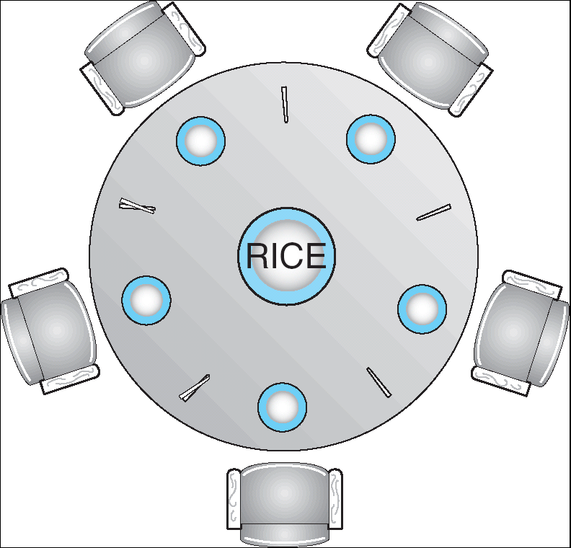
Dining-Philosophers Problem
Shared data
Bowl of rice (data set)
Semaphore chopstick [5] initialized to 1

Slide 53
Dining-Philosophers Problem (Cont.)
The structure of Philosopher i:
Do {
wait ( chopstick[i] );
wait ( chopStick[ (i + 1) % 5] );
// eat
signal ( chopstick[i] );
signal (chopstick[ (i + 1) % 5] );
// think
} while (true) ;

Slide 54
Dining-Philosophers Problem
Must satisfy mutual exclusion - no two philosopher can use the same fork at the same time.
Avoid deadlock and starvation!

Slide 55
Dining-Philosophers Problem
First attempt: take left fork, then take right fork
Wrong! Results in deadlock.
Second attempt: take left fork, check to see if right is available, if not put left one down. Still has race condition and can lead to starvation.

Slide 56
Suggestion to solve the problem
Allow at most four philosophers to be sitting simultaneously at the table.
Allow a philosopher to pick up her chopsticks only if both chopsticks are available.
An odd philosopher picks up her left chopstick first and even philosopher picks up her right chopstick first.

Slide 57
End of Chapter 5 Thank You

